Slide 1
Database class-2
Pollab Ahmed
SQA Engineer
Spring Rain Private Ltd

Slide 2
Content
Sub-queries
Key in SQL
Join
Normalization
Interview questions

Slide 3
Sub-queries
An SQL subquery is a query inside another query. It is used in the WHERE or HAVING clause of an SQL statement. Subqueries let you specify the results of one query as an argument in another query.
SELECT product_name FROM products WHERE product_price = (SELECT MAX(product_price) FROM products);
SELECT MAX(product_price) FROM products WHERE product_price NOT IN (SELECT MAX(product_price) FROM products);

Slide 4
Key in SQL
Primary key
Foreign Key
Composite key
Candidate key

Slide 5
Primary key
A primary key is a single column value used to identify a database record uniquely.
A primary key cannot be NULL
A primary key value must be unique
The primary key values should rarely be changed
The primary key must be given a value when a new record is inserted.

Slide 6
Foreign Key
Foreign Key references the primary key of another Table! It helps in connecting another Tables.
A foreign key can have a different name from its primary key
It ensures rows in one table have corresponding rows in another
Unlike the Primary key, they do not have to be unique. Most often they aren’t
Foreign keys can be null even though primary keys can not

Slide 7
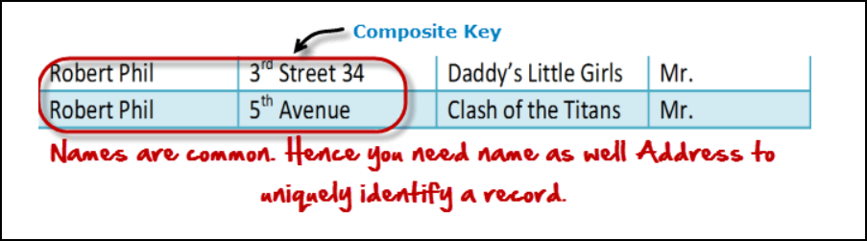
Composite key
A composite key is a primary key composed of multiple columns used to identify a record uniquely.
In our database, we have two people with the same name Robert Phil, but they live in different places.

Slide 8
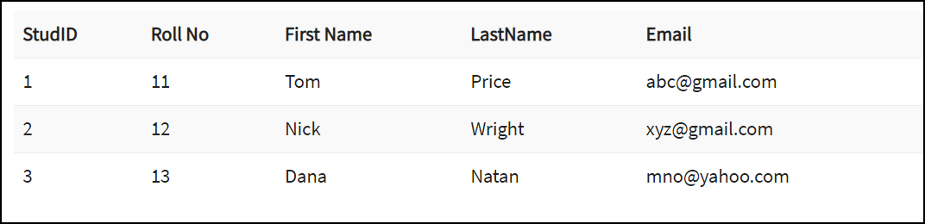
Candidate key
In a table, the columns which can be defined as a primary key, are individually a candidate key.

Slide 9
Join
Inner join/JOIN
Left join
Right join
Union

Slide 10
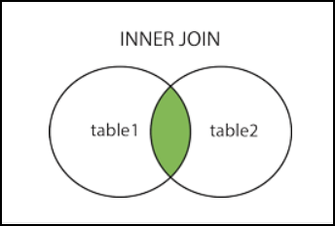
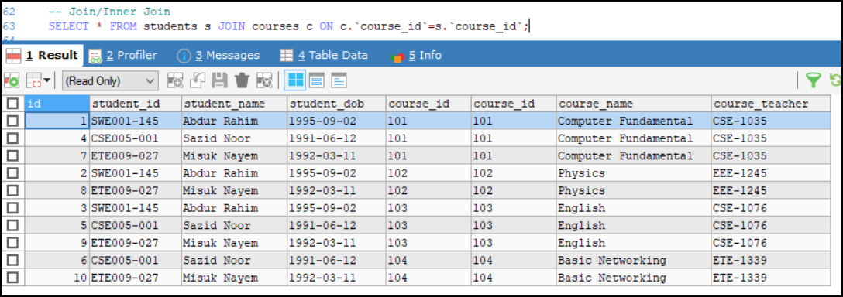
Inner Join

Slide 11
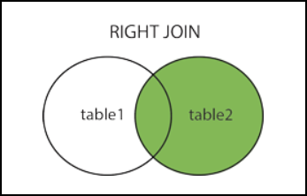
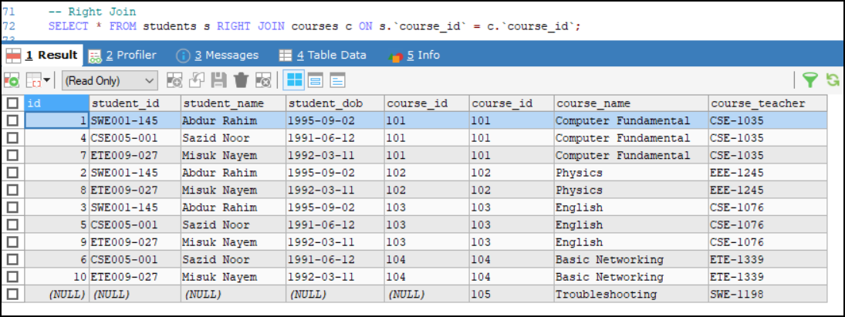
Right Join

Slide 12
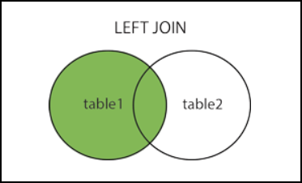
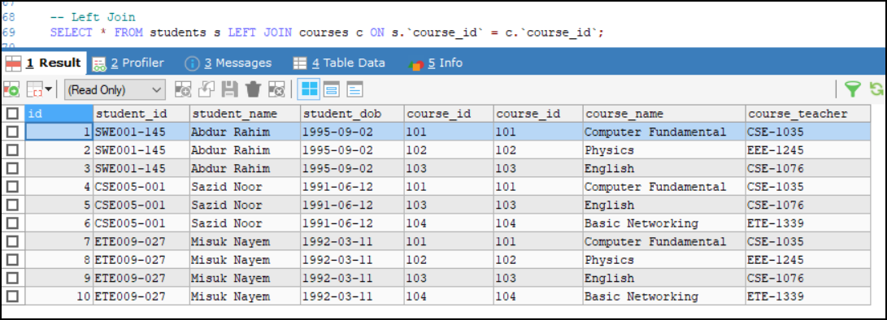
Left Join

Slide 13
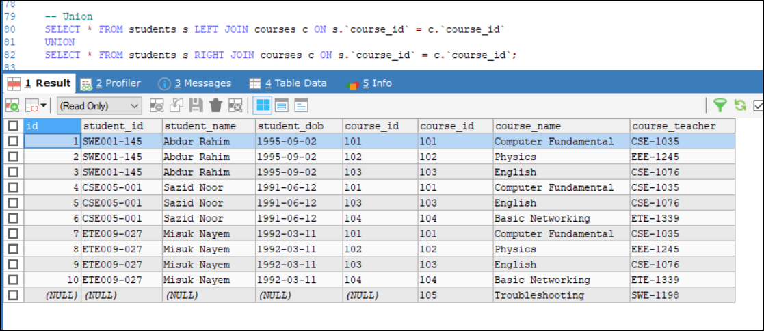
Union

Slide 14
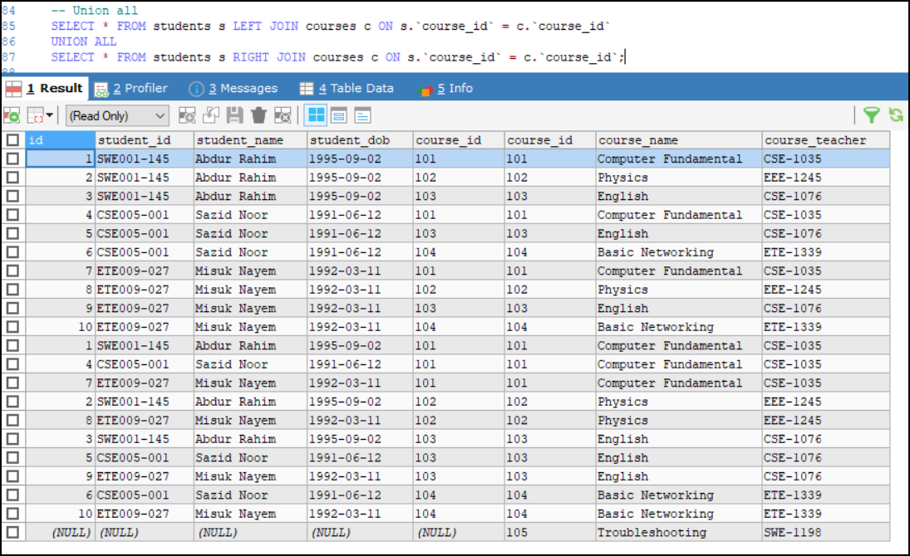
Union All

Slide 15
Normalization
Normalization is a way of organizing the data in the database. It divides a table into multiple tables to reduce data redundancy and dependency.
It helps developers to integrate entity relationship model thus CRUD operation can be done easily.
Normalization need to be done at the early stage of database construction. Otherwise, the whole database will be reconstructed at the later stage.

Slide 16
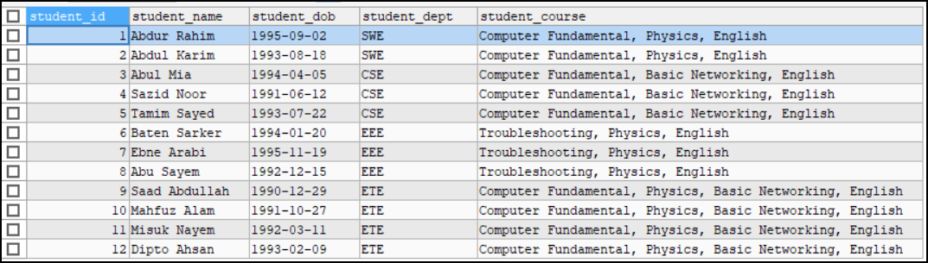

Slide 17
1st Normal Form
Rule:
Each table cell should contain a single value.
Each record needs to be unique.

Slide 18
2NF
Rule:
Rule 1 - Be in 1NF
Rule 2- All the non-key attribute of the table is fully dependent on the primary key.

Slide 19
3NF
Rule 1- Be in 2NF
Rule 2- Has no transitive functional dependencies

Slide 20
More Normal Forms
BCNF(3.5)(Boyce-Codd Normal Form)(Mapping table)
4NF
5NF
6NF

Slide 21
Interview Questions
1. What is Primary key, Foreign key, Candidate key, Cascading?
2. Differentiate between delete, truncate and drop.
3. Difference between DBMS and RDBMS.
4. What do you understand by data redundancy?
5. What are the various types of relationship in database?
6. What is BCNF?
7. What is stored procedure?
8. Do you know the aggregate functions of database?
9. Explain, Inner, Left, Right and Cross join.
10. Find the 2nd highest product price.

Slide 22
Any Questions?

